Slide 1
Final Project
吳紹齊
Notes:
Today, I'm going to introduce my final project

Slide 2
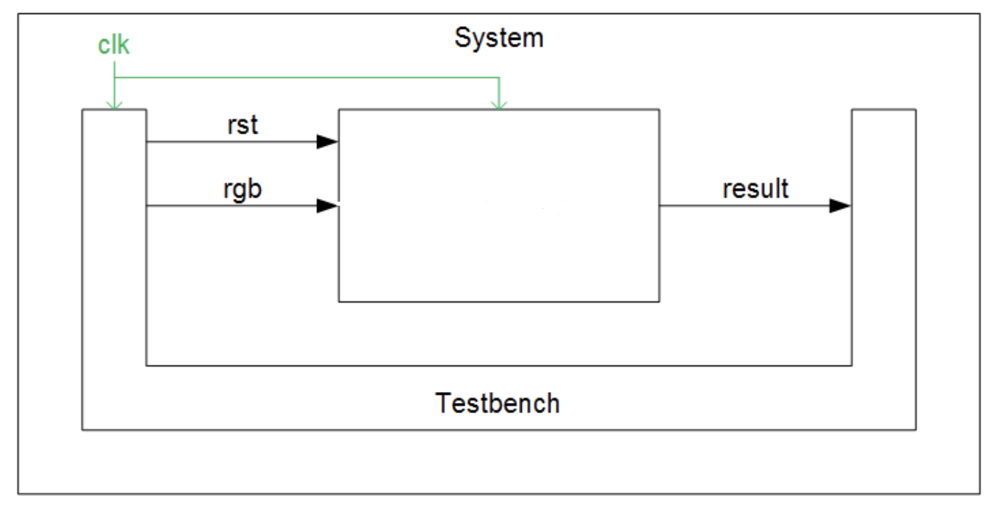
HLS structure
Gaussian Blur
+ Laplacian Sharpen
Notes:
Here is the architecture diagram of high-level synthesis. first, I use Gassian Blur to perform data smoothing processing, which can effectively remove noise and smooth the boundary, and then perform sharpening processing through Laplacian sharpen to make the picture clearer and more detail.
這裡是High level systhesis的架構圖，我這裡採用的是先經過Gassian Blur，進行數據平滑處理，可以有效的將噪聲去除和平滑邊界，再經過Laplacian sharpen去進行銳化處理，可以使圖片看起來更清晰。

Slide 3


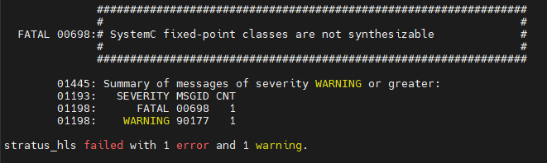
HLS-Cynw
Notes:
Because the calculation of Gaussian blur needs to use fixed point, but fixed-point classes are not synthesizable, so must include cynw_fixed header, so that fixed point can be synthesizable.

Slide 4
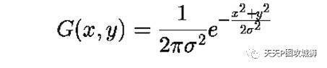
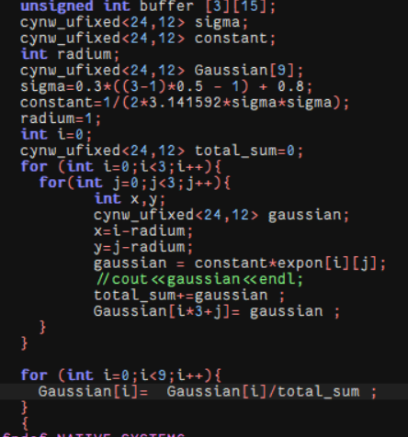
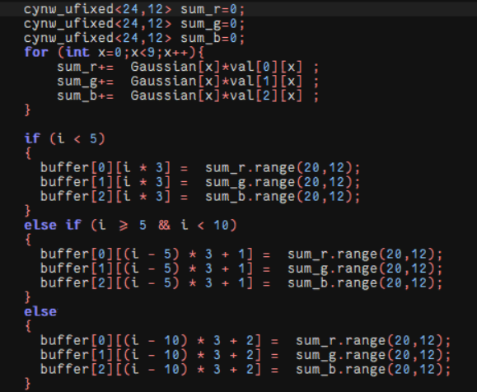
Gaussian Blur
Notes:
The left picture is the parameter calculation of Gaussian blur. Because fixed point is needed, the datatype adopts cynw_ufixed, and the kernel size is 3 by 3. The right picture is to do Gaussian blur. It’s essence to perform convolution. After the completion, only the integer part is taken .
左圖是Gaussian blur的參數計算，因為需要用到fixed point ，所以datatype採用 cynw_ufixed，kernel 尺寸為3乘3，右圖就是去做Gaussian blur，它本質就是進行convolution，做完後，只取整數部分。

Slide 5
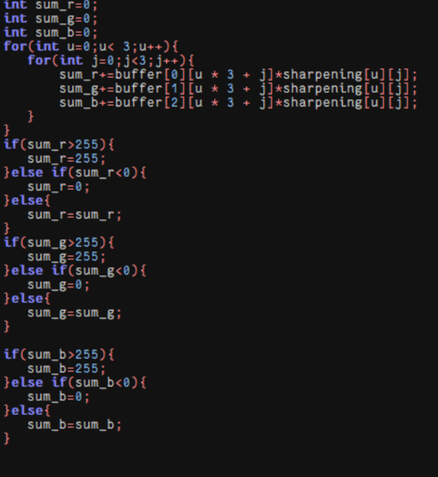
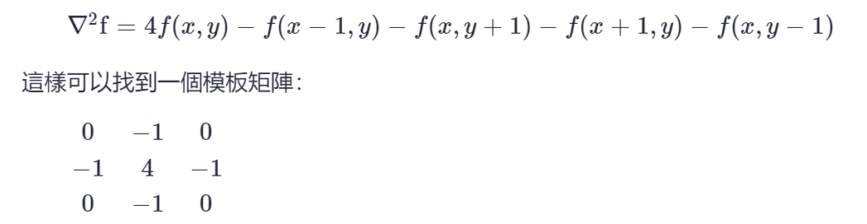
Laplacian Sharpen
Notes:
This part is to perform Laplacian Sharpen. After the sharpening mask is used for convolution, the value lower than 0 or higher than two hundred fifty-five is truncated.
這部分是進行Laplacian Sharpen，將sharpening mask去做convolution後，截去低於0或高於255的數值。

Slide 6
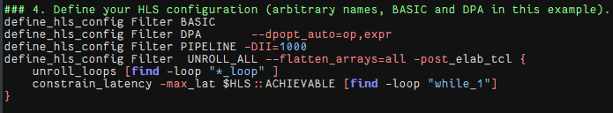
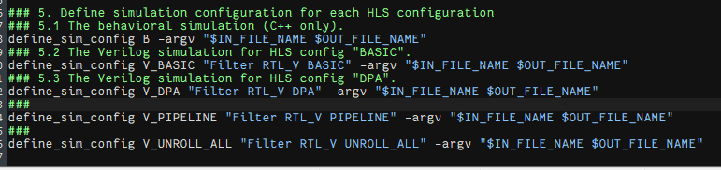
Project.tcl
Notes:
Here is project.tcl, I made BASIC, DPA, PIPELINE, UNROLL and so on.
這裡是project.tcl，我做了BASIC、DPA、PIPELINE、UNROLL等指令。

Slide 7
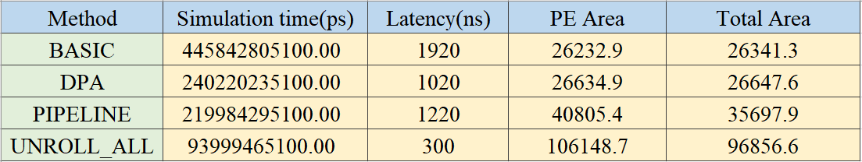
HLS RESULT
Notes:
Here is the result. You can see that the simulation time and latency of Unroll is the least, because the loops are all expanded and synthesized, so the speed is the fastest, but the disadvantage is that the area is very large.
這裡是結果，可以看到Unroll的simulation time最少，因為loop都展開合成了，所以速度最快但缺點是面積非常大。

Slide 8
RISCV-VP
ISS
Core 0
ISS Core 1
DMA
Memory
BUS
PE 0
PE 1
Notes:
This is the riscv-vp platform architecture diagram of the Multicores architecture. There will be a total of 2 Cores to drive indepent PEs for computing.

Slide 9
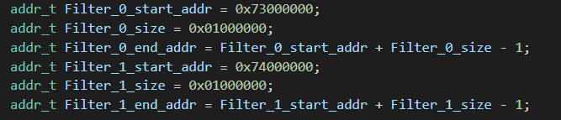



RISCV-VP-main.cpp
Notes:
Here is the main.cpp of RISCV-VP, I added more PE here, gave a new address, and then connected the new PE to the BUS
這裡是RISCV-VP的main.cpp裡，我這邊多加的PE，給了新的address，再將新的PE接上BUS

Slide 10

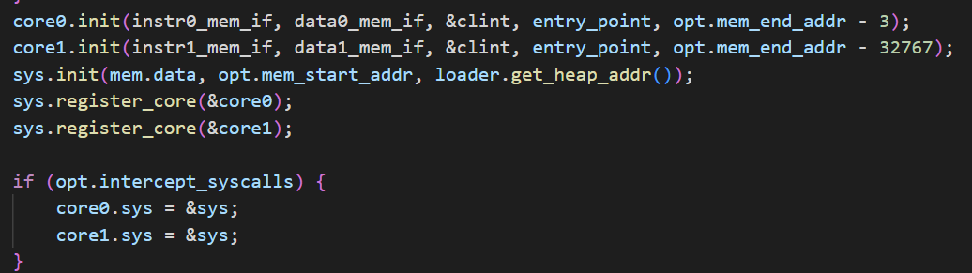
RISCV-VP-main.cpp
Notes:
Here is two cores, I use a total of two cores for calculation.
這裡是2個cores，我一共使用兩個core來計算。

Slide 11
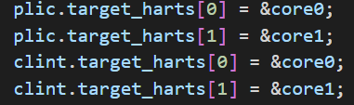
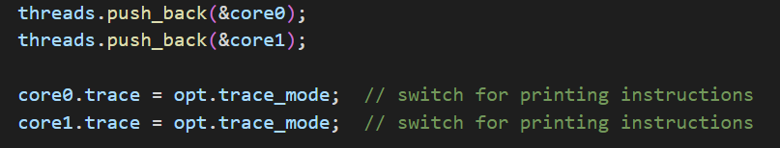
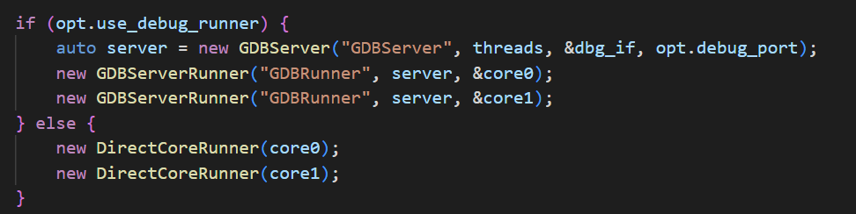
RISCV-VP-main.cpp
Notes:
here is connect interrupt signals and switch for printing instructions。

Slide 12
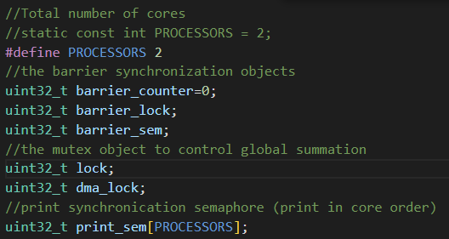
Software
Notes:
here is the barrier synchronization objects and the mutex object to control global summation 。

Slide 13
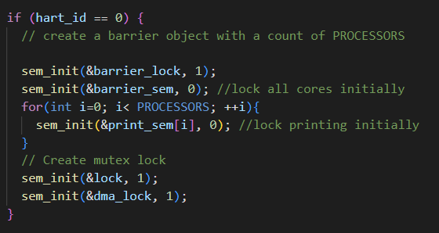
Software
Notes:
create mutex lock and create a barrier object

Slide 14
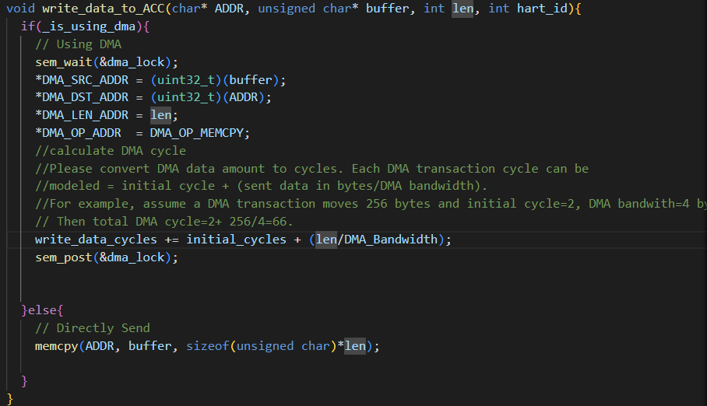
Software-DMA
Notes:
Use DMA to transfer data, use dma lock to control global summation, and calculate the total cycle of DMA
使用DMA來傳送資料，並使用dma lock來控制 global summation，還有計算DAM 的 total cycle

Slide 15
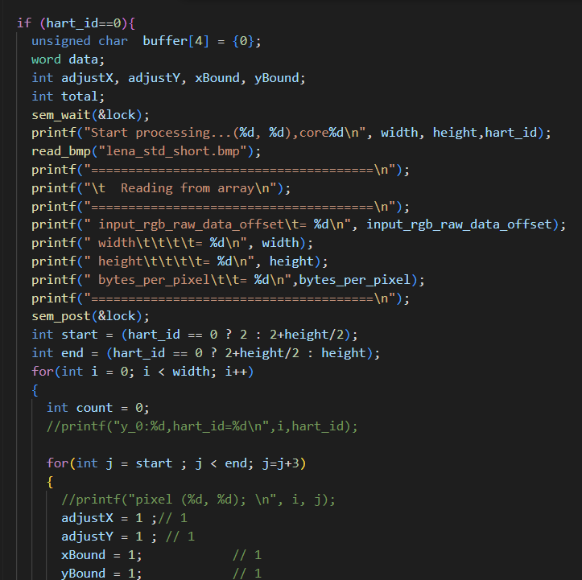
Software
Notes:
Here is to read the initial state of bmp, and distinguish which part to do according to hart_id, which is core 0 or core 1. Here, I divide the height of the picture into two parts for different cores to calculate.
這裡是讀取bmp初始狀態，並根據hart_id也就是core 0或core 1去區分要做哪部分，我這裡將圖片的高分成兩部分給不同core去計算。

Slide 16
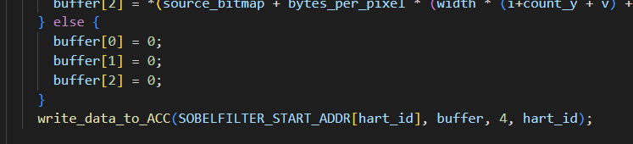
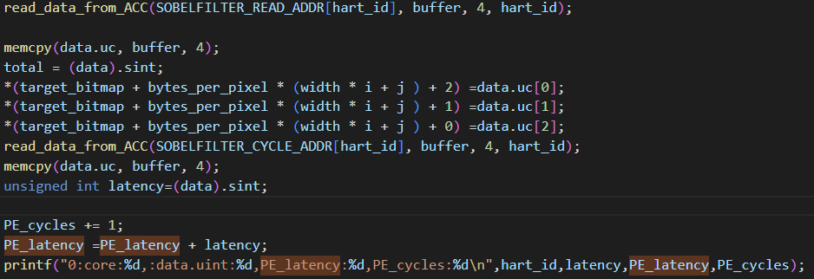
Software
Notes:
Write different addresses according to different cores, and calculate PE cycles and PE latency when output
根據不同的core 來去寫入不同的address，並在輸出的時候計算PE的cycles和PE的latency

Slide 17
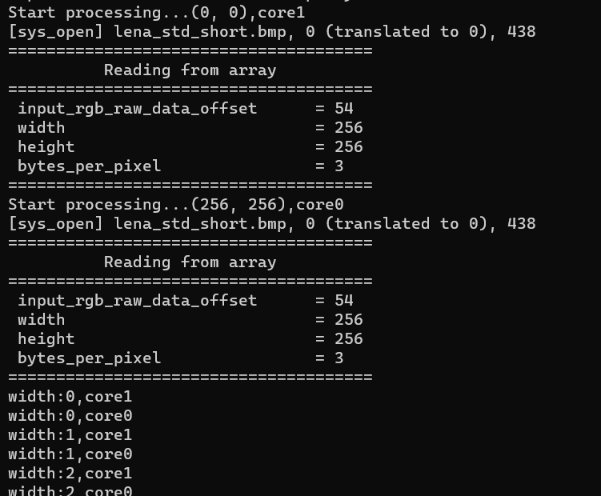
change Core
Notes:
You can see that the core on the right picture is always exchanging output
可以看到右圖的core在一直交換輸出

Slide 18

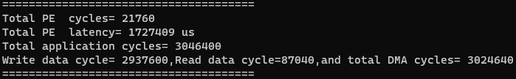
Comparison
Notes:
The top picture is single core result, the middle picture is DMA cycles PE computation cycles, and total application cycles, the bottom picture is multi-core result, there are a little less simulation time and Num-instr using DMA, and then use multi-core simulation time and Num-instr is one-third times less than using single core
最上圖是single core result，中圖是DMA cycles PE computation cycles ,and total application cycles，最下圖是 multi-core result，有使用DMA的simulation and Num-instr比較少一點，然後使用multi-core的simulation and Num-instr比使用single core少了1/3倍

Slide 19
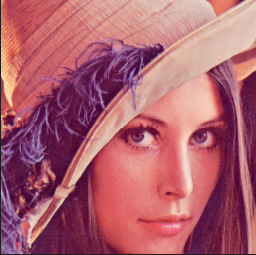
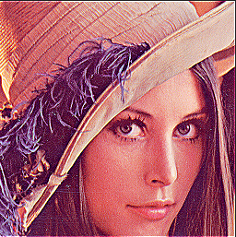

Result
Original
Sharpen
Guassian+Sharpen
Notes:
You can see that the image that is directly sharpened looks a lot of noise, but the image that has been sharpened after Gaussian blur looks smoother, and it is smoother than the original image more details.
可以看到直接進行銳化處理的圖片看起來噪點很多，但有先經過高斯模糊再銳化的圖片看起來就更平滑了，而且比原圖更多細節

Slide 20
THANK YOU
Notes:
Today, I'm going to introduce my final project

